Slide 1
Structure of forsterite at extreme conditions using laser shock compression
Nara Anusonti-Inthra
Science and Mathematics Academy, Aberdeen High School
Prof. June Wicks and Patrick LaChapelle
Notes:
Hi I am Nara and I go to the SMA
This summer under the guidance of June and pat I studied the structure of forsterite….

Slide 2
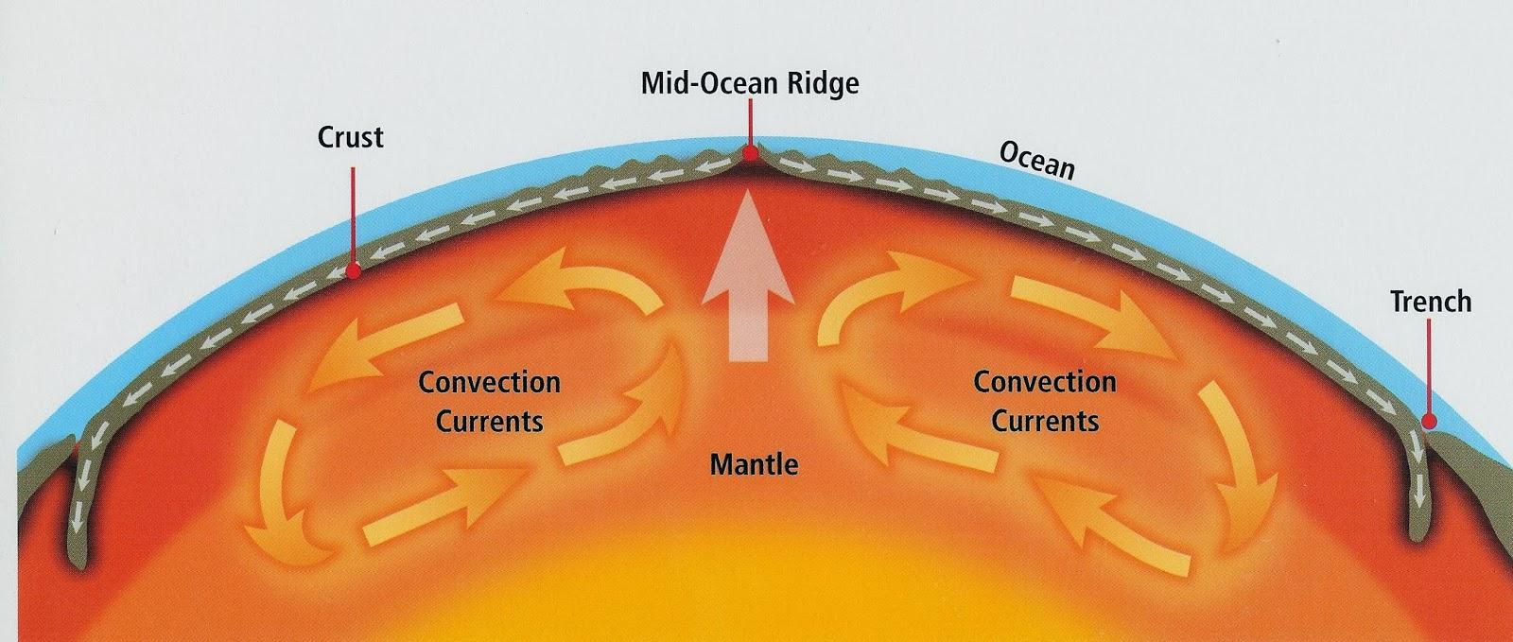
Forsterite
Main component of the mantles of rocky planets
Its phase transitions provide insight into the formation, evolution, and habitability of rocky exoplanets
Plays a role in creating and shaping convection currents, influencing factors essential to habitable surface conditions
Its phase transitions
Notes:
-Forsterite is a very important mineral to study in the field of planetary science
-It is a main component in the Earth’s upper mantle and expected to be in rocky exoplanets
-its phase transtions can tell us a lot about the formation evolution and habitability of rocky exoplanets
-mainly, plays a role in creating and shaping convection currents -> plate tectonics and magnetosphere -> surface conditions suitable to support life
-during the formation of a planet it also affects the cooling of the early magma ocean stage of planet formation, which contributes to geochemistry and thermal evolution of a planet
-the phase transitions of forsterite inside the earth’s mantle are a factor in deep earthquake generation, which are less damaging than earthquakes that occur closer to the surface, but affect a larger area
-the phase transitions of forsterite at these high pressures and temperatures are very hard to study and need to be experimentally proven
-an important phase transition that is predicted is incongruent melting

Slide 3
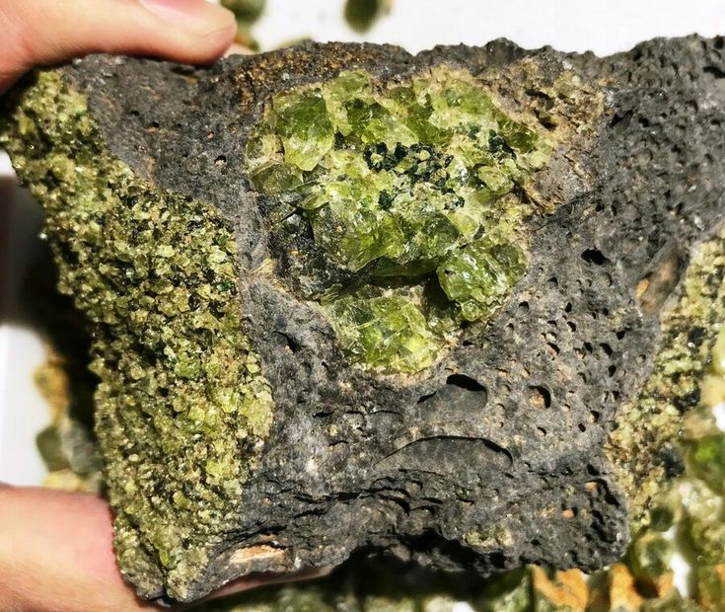
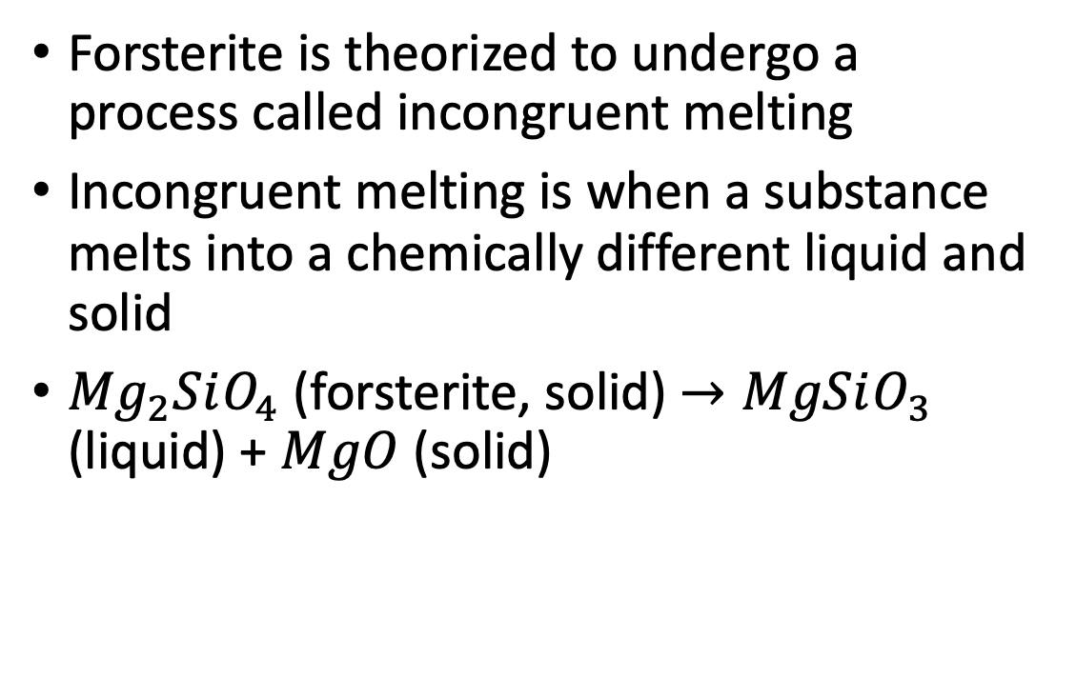
Incongruent melting
Forsterite is theorized to undergo a process called incongruent melting
Incongruent melting is when a substance melts into a chemically different liquid and solid
${Mg}_{2}SiO_{4}$ (forsterite, solid) $→MgSiO_{3}$ (liquid) + $MgO$ (solid)
Crystal forsterite at the surface
Notes:
-studying the phase transitions of forsterite
-this is just one of the possible ways forsterite will behave
-we are looking for crystal MgO in our experiment
-

Slide 4
Previous studies
Evidence supporting incongruent melting has been found in only two studies, but when it occurs is currently inconclusive
Sekine et al. (2016) – found slope changes in the hugoniot (pressure v density) attributed to incongruent melting at 271 to 285 GPa
Root (2018) – attempted to replicated Sekine et al. but did not get the same results
Newman (2018) – used X-ray diffraction and found evidence for incongruent melting at 150 to 195 GPa
Notes:
-Sekine measured the density for the hugoniot, and attributed slope changes to incongruent melting
-Root suggested that the pressure range found in Sekine is too high and suggested using X-ray diffraction
-X-ray diffraction is more accurate because it actually measures the crystal structure of the sample, which is more reliable than just a density measurement
-Newman’s dissertation used x-ray diffraction and found evidence at a lower pressure
-therefore this current experiement attempts to investigate this by using x-ray diffraction and conducting experiments at 150 and 260 GPa

Slide 5
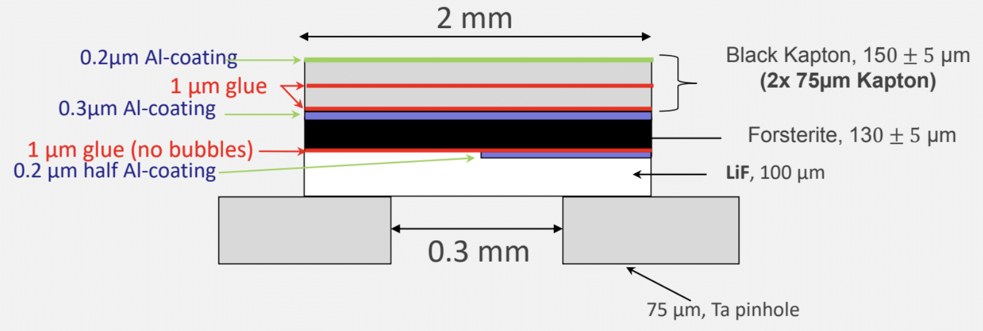
Laser shock compression
The extreme pressures needed for this experiment are generated using laser produced shock waves
The sample consisted of a 150 𝜇𝑚 thick Kapton ablator, 130 𝜇𝑚 of powdered forsterite, and 100 𝜇𝑚 of window material (LiF)
As the laser hits the sample, the ablator expands backwards, creating a uniform shock wave through the sample
Notes:
-the laser we use is the Omega-EP laser from the Laboratory for laser Energetics in Rochester
-window is used for VISAR shock wave velocity measurements (not applicable now)
-demonstrate with the picture
-the ablator evaporates, expanding backwards to create a shock wave to reach the high pressure and temperatures

Slide 6
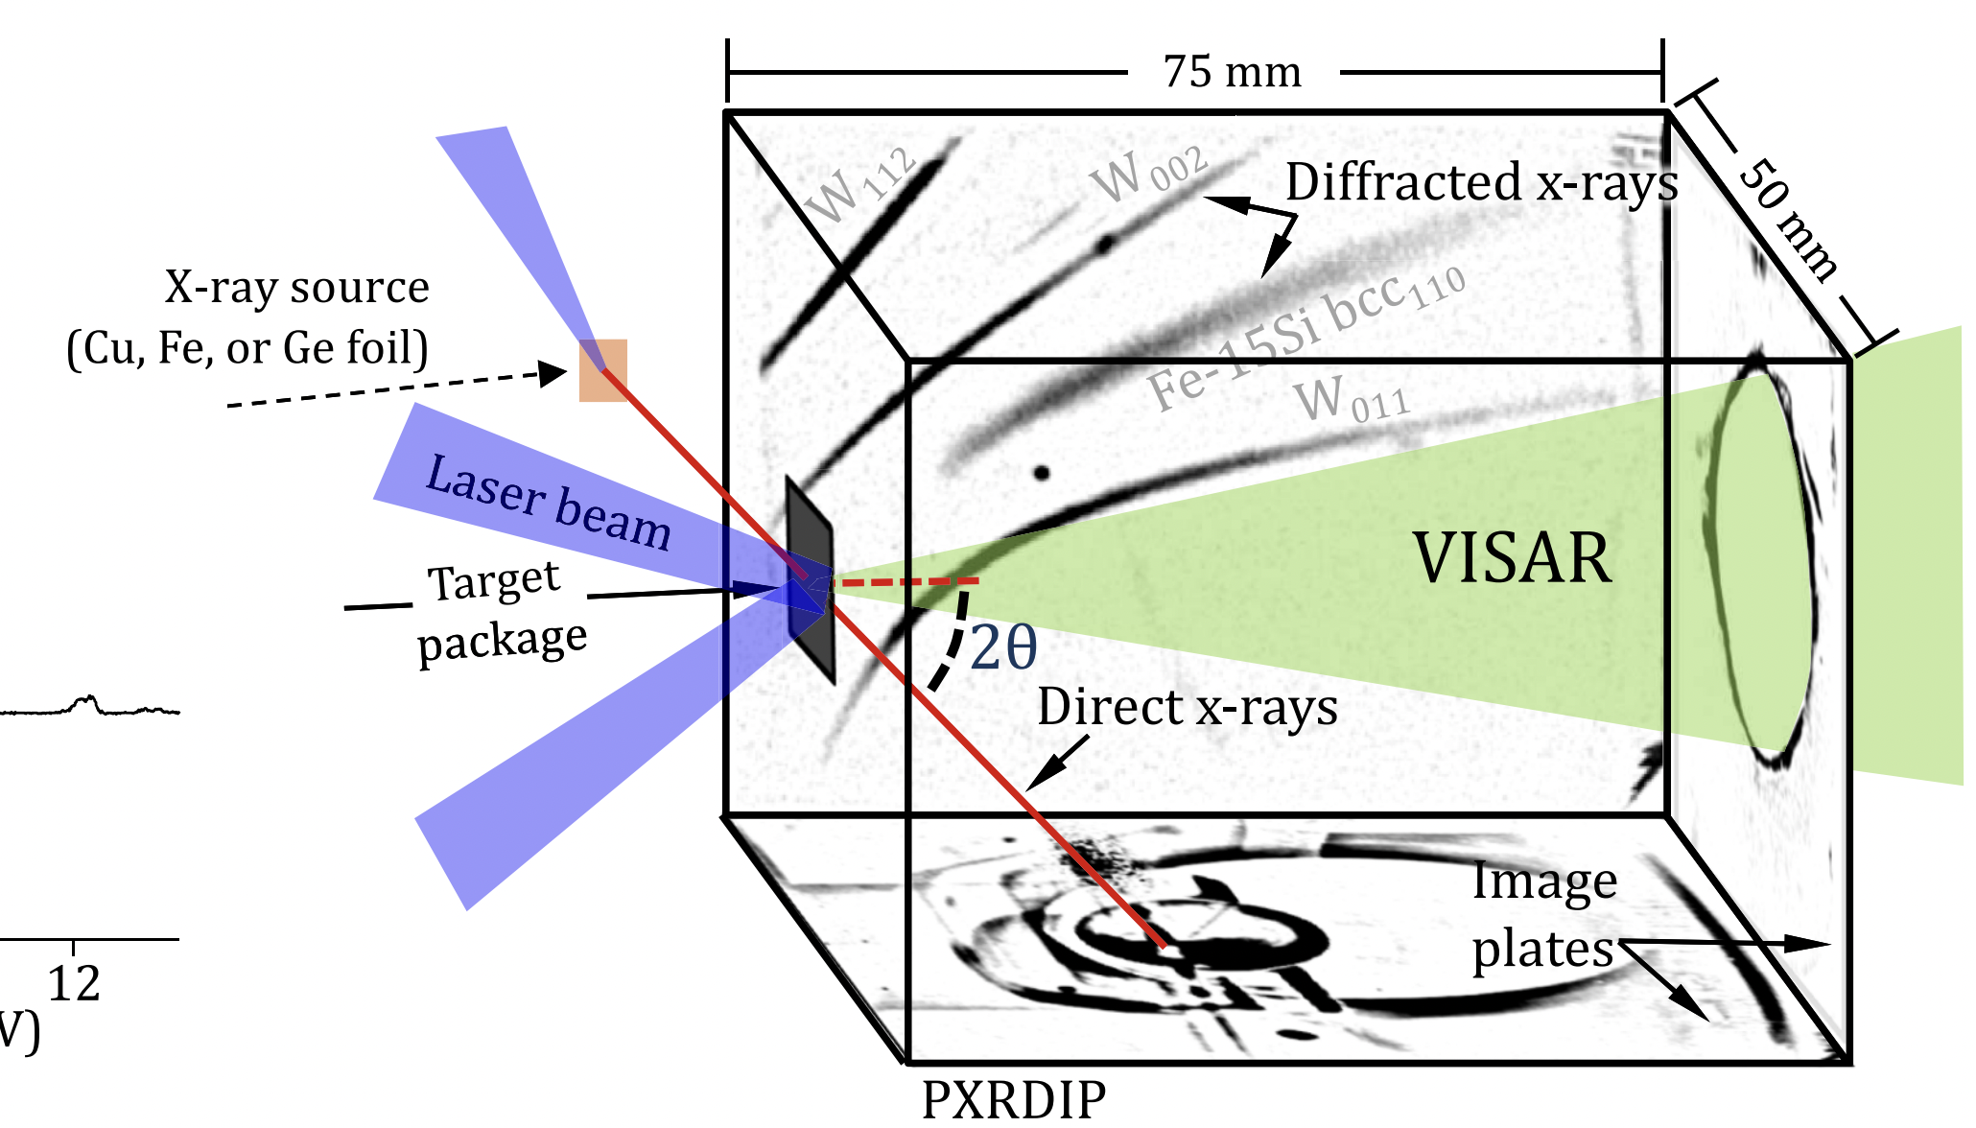
PXRDIP
Powder X-ray Diffraction Image Plates
X-rays are diffracted according to the structure of the sample, and then picked up by the image plates
The sample is held by a Ta (tantalum) pinhole, which is used for proper data alignment
Wicks, J. K., Smith, R. F., Fratanduono, D. E., Coppari, F., Kraus, R. G., Newman, M. G., Rygg, J. R., Eggert, J. H., & Duffy, T. S. (2018). Crystal structure and equation of state of Fe-Si alloys at super-Earth core conditions. Science advances, 4(4), eaao5864. https://doi.org/10.1126/sciadv.aao5864
Notes:
-PXRDIP stands for … and is used for determining the structure and composition of the sample
-a laser generated Copper plasma sends x-rays through the sample after the shock wave
-these x-rays are diffracted according to structure and picked up by the box of image plates
-the sample is held in a tantalum pinhole, which focuses the x-rays on the sample and helps align the data
-x-rays from tantalum diffracting can also be seen on the PXRDIP, and as the way ta diffracts is well known and measured, the data can be calibrated properly

Slide 7
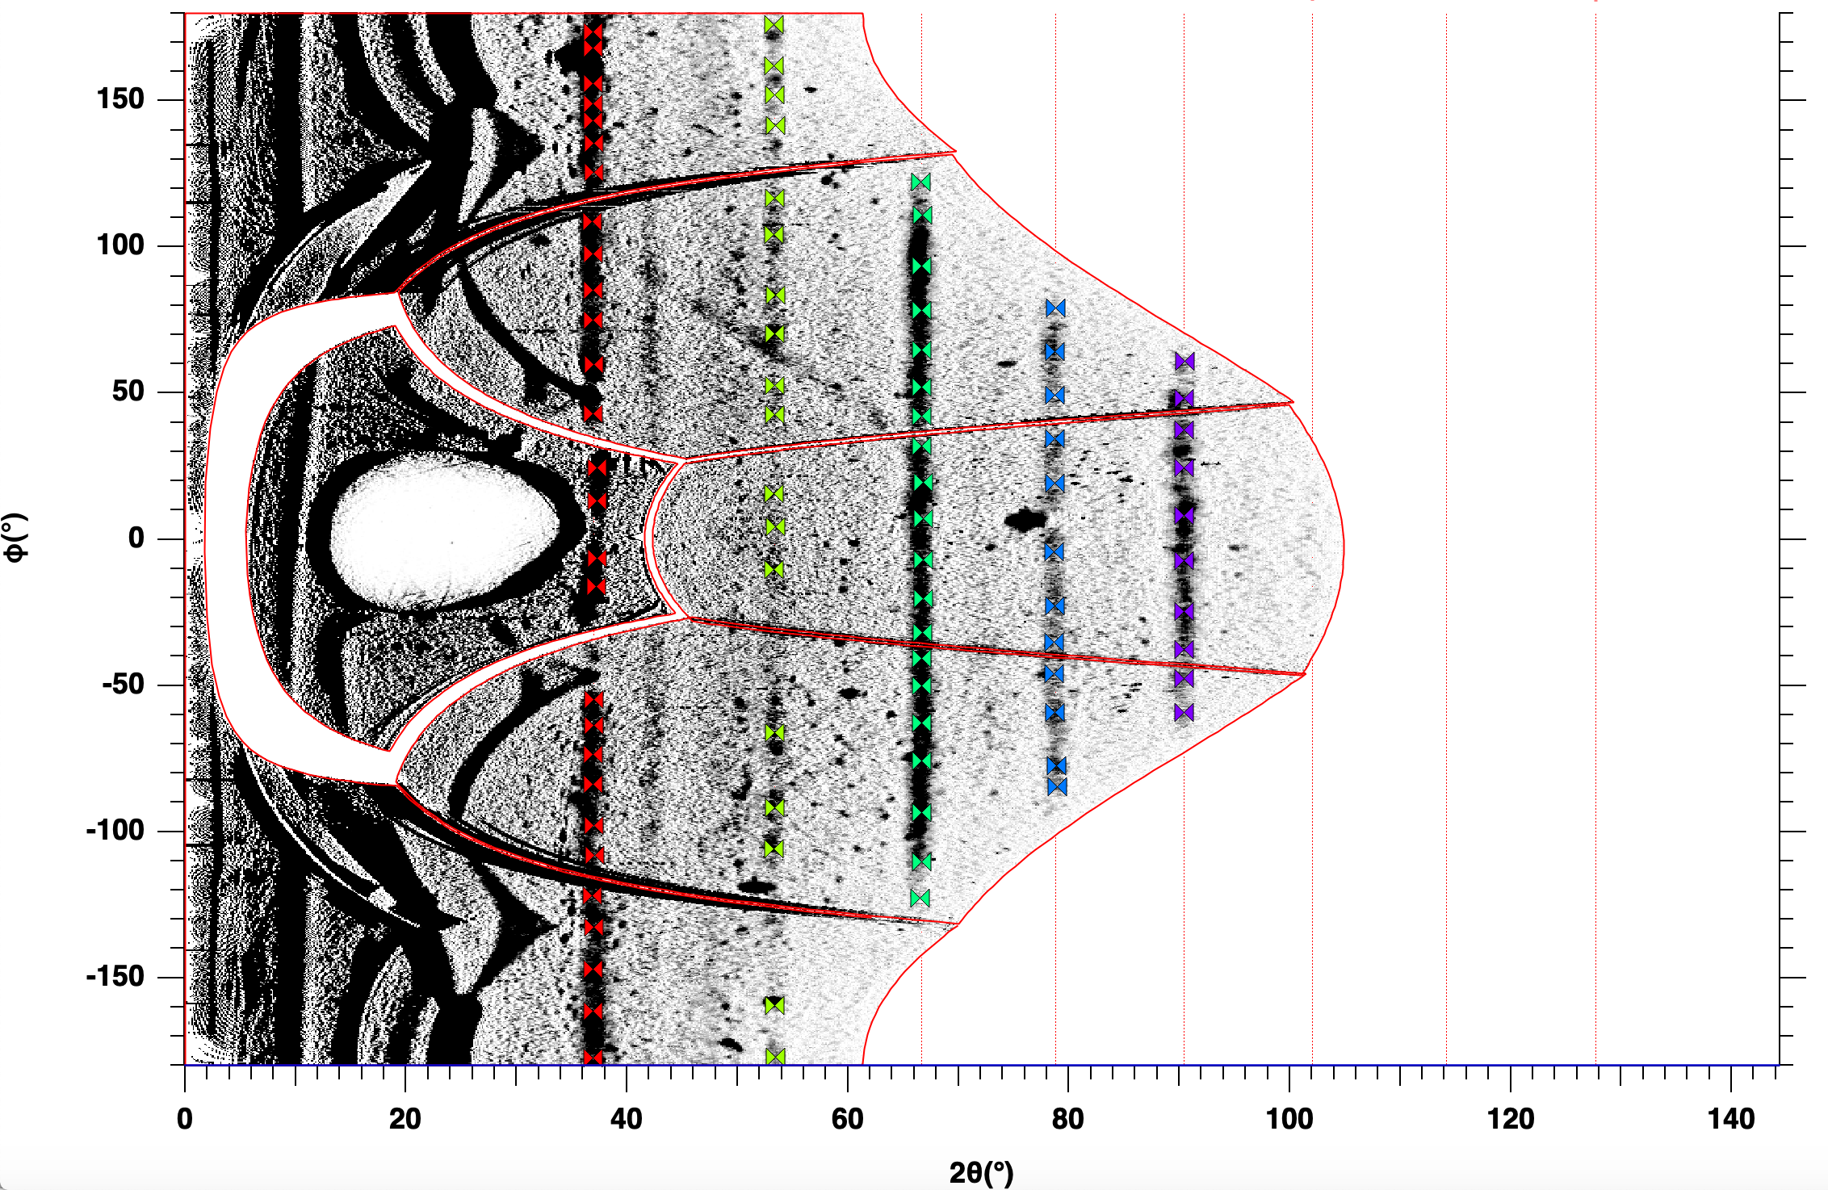
PXRDIP analysis
After integration along the azimuthal angle, diffraction peaks are found
Diffraction peaks are translated into d-spacing (inter-atomic spacing in the lattice)
Each material has a characteristic d-spacing and diffraction pattern
Notes:
-the raw data is dewarped to a polar view
-after it is aligned with the flags it is integrated up and down to find the diffraction peaks, which is where the x-rays are concentrated due to the crystal structure
-because we used a powder they show up in these lines
-after the 2-theta location is found it’s translated to d-spacing
-once you have the diffraction peaks you must identify what material it belongs to
-each material has its own unique d-spacing and diffraction pattern, crystal diffraction and d-spacing plots were used to identify each peak

Slide 8
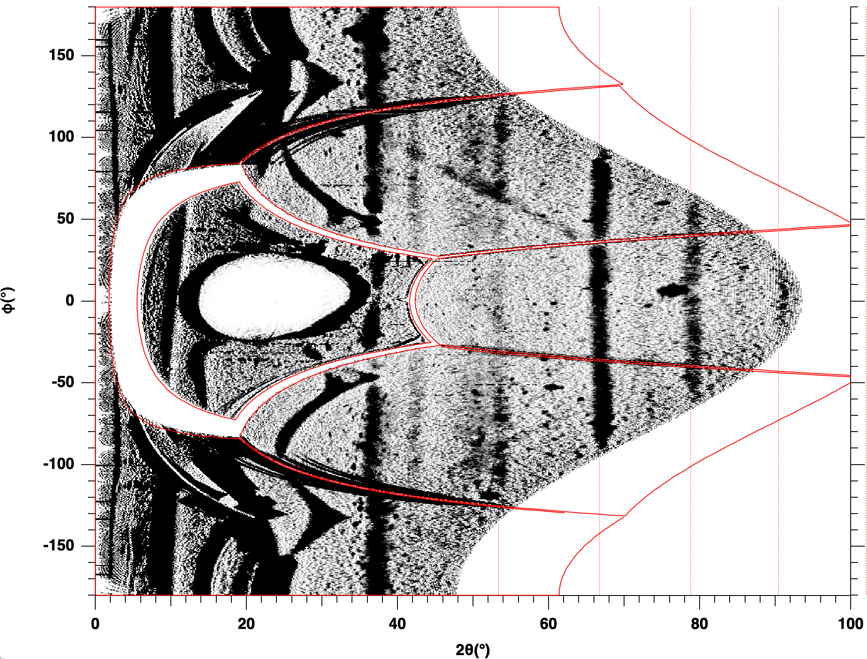
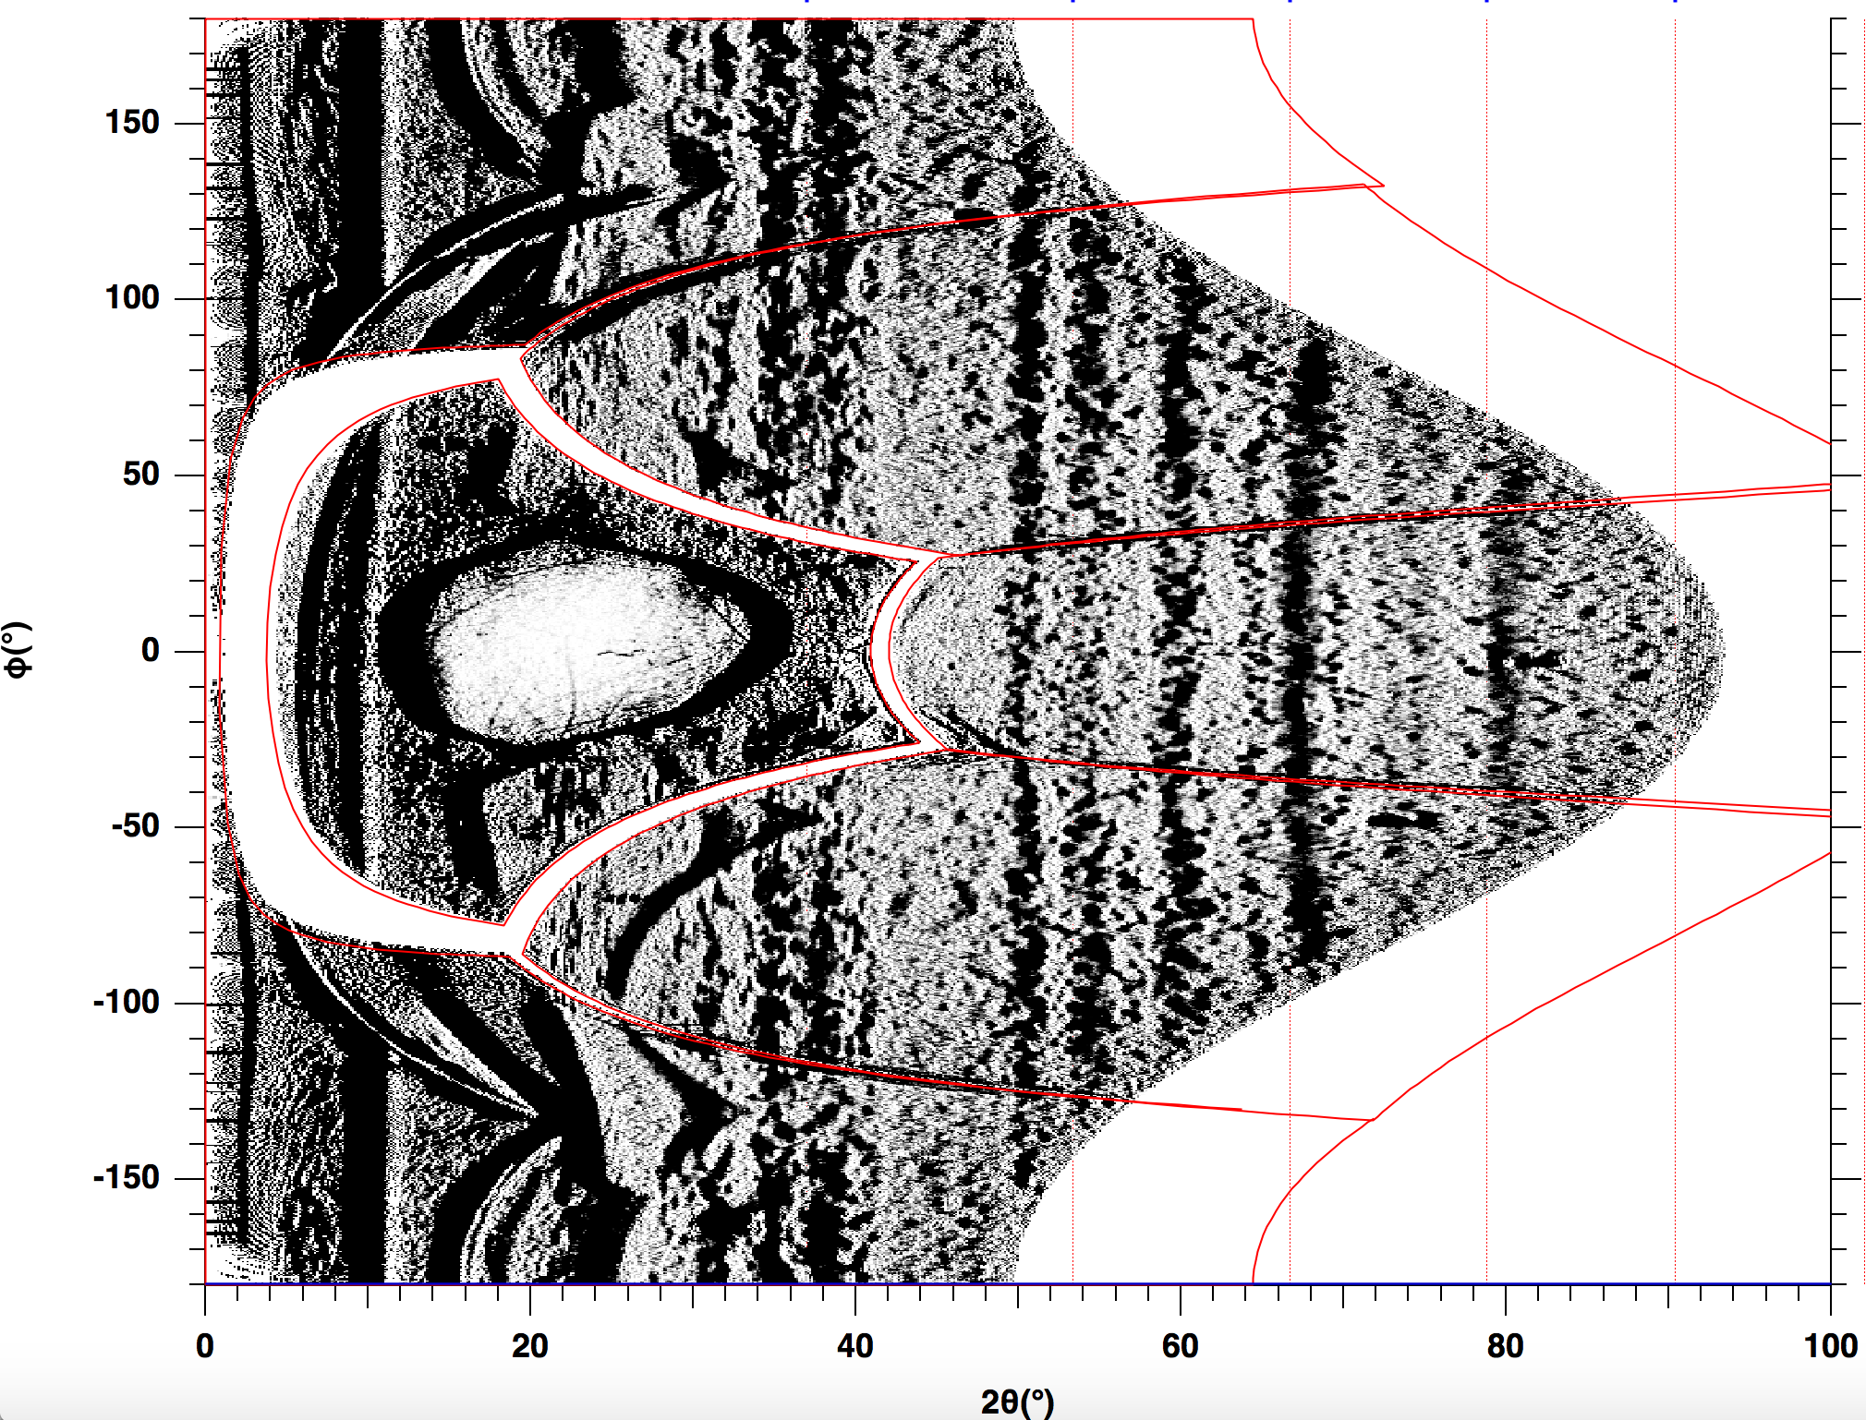
Results - PXRDIP
260 GPa
150 GPa

Slide 9
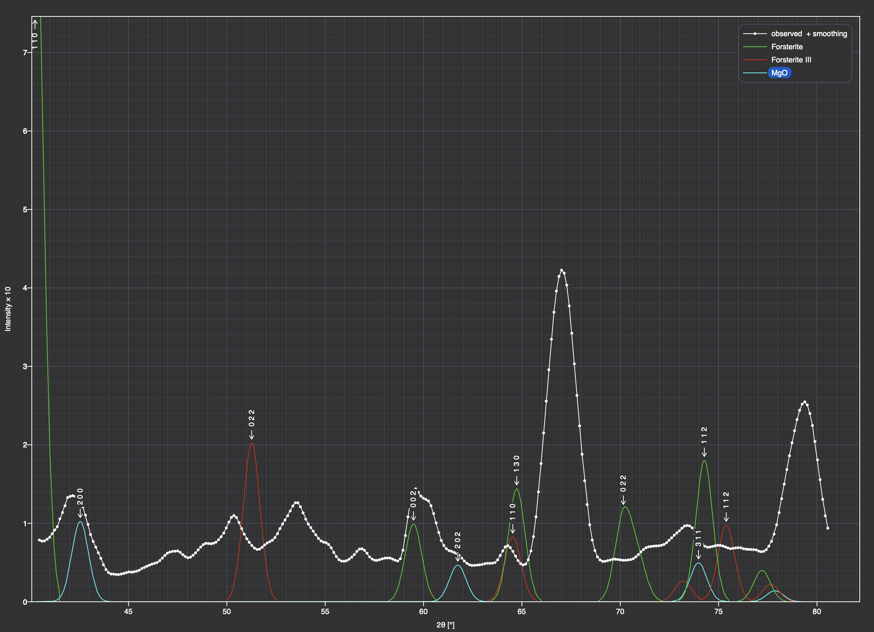
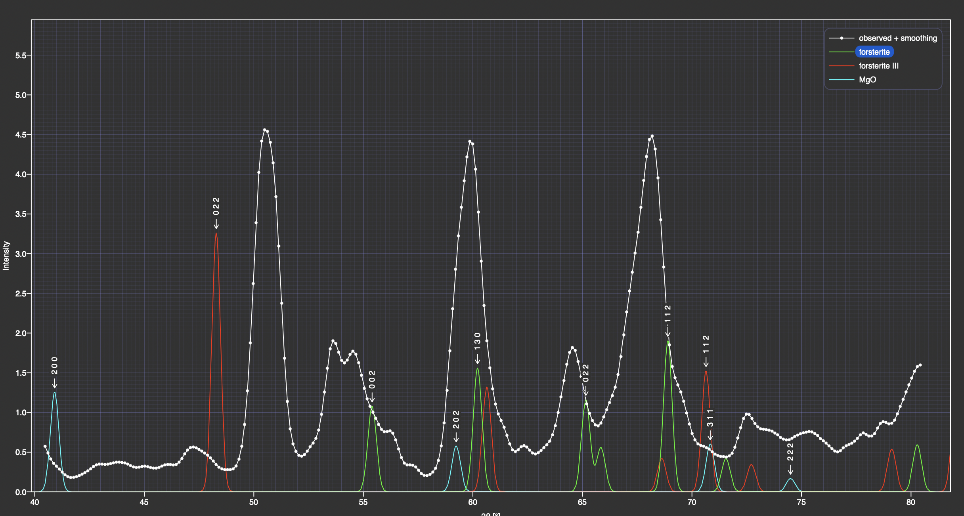
Results – Crystal diffract
Observed
Forsterite
Forsterite III
MgO
260 GPa
150 GPa

Slide 10
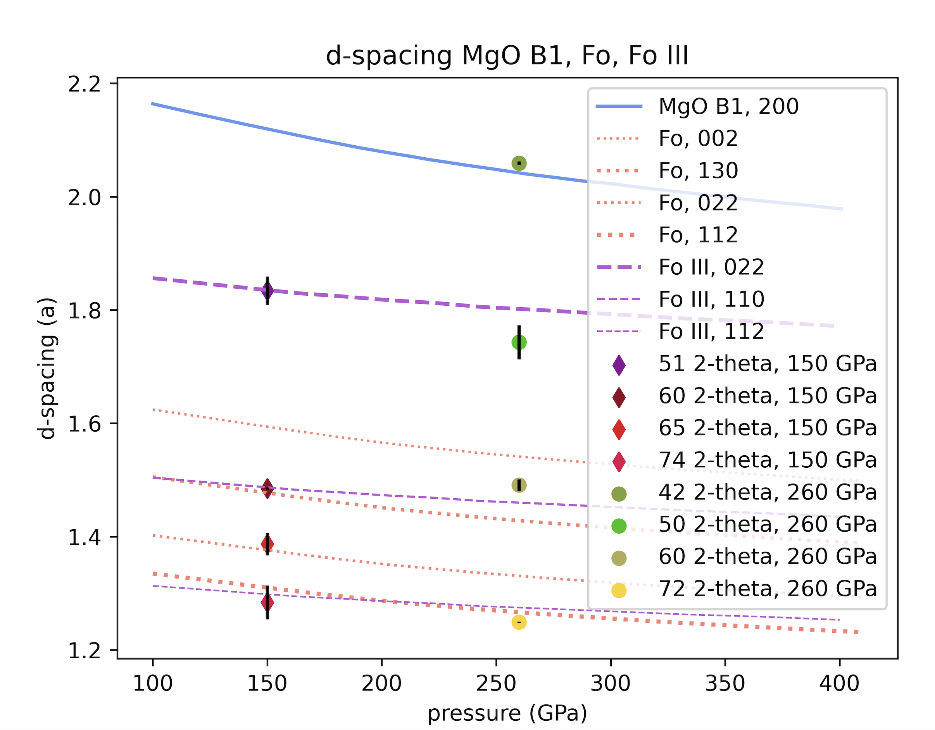
Results - d-spacing

Slide 11
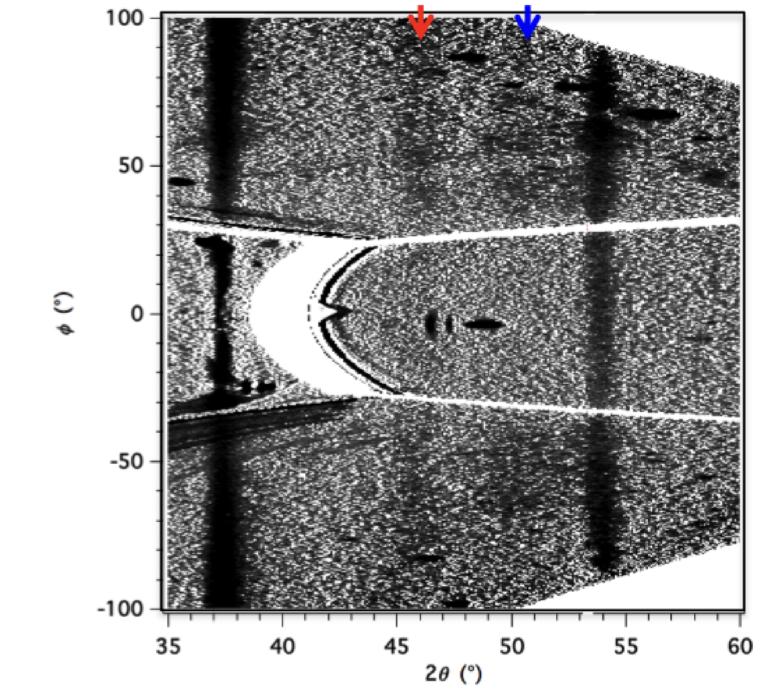
Newman (2018)

Slide 12
Results - PXRDIP
260 GPa
150 GPa

Slide 13
Conclusion
The experiment conducted at 260 GPa shows signs of incongruent melting because of evidence implying crystal MgO and liquid forsterite
Pressure range found agrees with Sekine (2016)
X-ray diffraction results agree with Newman (2018), but at a different pressure

Slide 14
Next steps
Analyze VISAR data to verify the data from PXRDIP
Conduct more experiments to verify these findings

Slide 15
Thank you!
*add picture of everyone

Slide 16
References
Sekine, T., Ozaki, N., Miyanishi, K., Asaumi, Y., Kimura, T., Albertazzi, B., ... & Kodama, R. (2016). Shock compression response of forsterite above 250 GPa. Science Advances, 2(8), e1600157.
Root, S., Townsend, J. P., Davies, E., Lemke, R. W., Bliss, D. E., Fratanduono, D. E., ... & Jacobsen, S. B. (2018). The principal Hugoniot of forsterite to 950 GPa. Geophysical Research Letters, 45(9), 3865-3872.
Kim, D., Tracy, S. J., Smith, R. F., Gleason, A. E., Bolme, C. A., Prakapenka, V. B., ... & Duffy, T. S. (2021). Femtosecond X‐ray Diffraction of Laser‐shocked Forsterite (Mg2SiO4) to 122 GPa. Journal of Geophysical Research: Solid Earth, 126(1), e2020JB020337.
Newman, M. G. (2018). On the Kinetics of Materials of Geophysical Interest (Order No. 30556695). Available from ProQuest Central; ProQuest Dissertations & Theses Global. (2838439956). https://doi.org/10.7907/Z9319T35 https://proxy1.library.jhu.edu/login?url=https://www.proquest.com/dissertations-theses/on-kinetics-materials-geophysical-interest/docview/2838439956/se-2
Wicks, J. K., Smith, R. F., Fratanduono, D. E., Coppari, F., Kraus, R. G., Newman, M. G., Rygg, J. R., Eggert, J. H., & Duffy, T. S. (2018). Crystal structure and equation of state of Fe-Si alloys at super-Earth core conditions. Science advances, 4(4), eaao5864. https://doi.org/10.1126/sciadv.aao5864

